Slide 1
REAL ESTATE PRICE PREDICTION
group 2:
Bharath Marturu
Kavya mannava
Kowsalya muralidharan
SHIVANAND REDDY PULAKANTI
Shivani bommidi

Slide 2





MEET OUR TEAM
Bharath Marturu
Kavya Mannava
Kowsalya Muralidharan
Shivanand Reddy Pulakanti
Shivani Bommidi

Slide 3

AGENDA
INTRODUCTION
MOTIVATION
SYSTEM DESIGN
TECHNOLOGY
DEMO
FUTURE WORK

Slide 4
INTRODUCTION
In a dynamic and complex market such as Delhi, accurately forecasting property prices is crucial for informed decision-making. This system utilizes advanced machine learning algorithms to analyze historical data, market trends, and various parameters, providing stakeholders with reliable insights for navigating the vibrant real estate landscape.

Slide 5
motivation
Dynamic market makes accurate price prediction difficult.
Need for a model that uses detailed parameters (e.g., location, size) for precise estimations.
Objective: Equip buyers and sellers with accurate price insights.

Slide 6
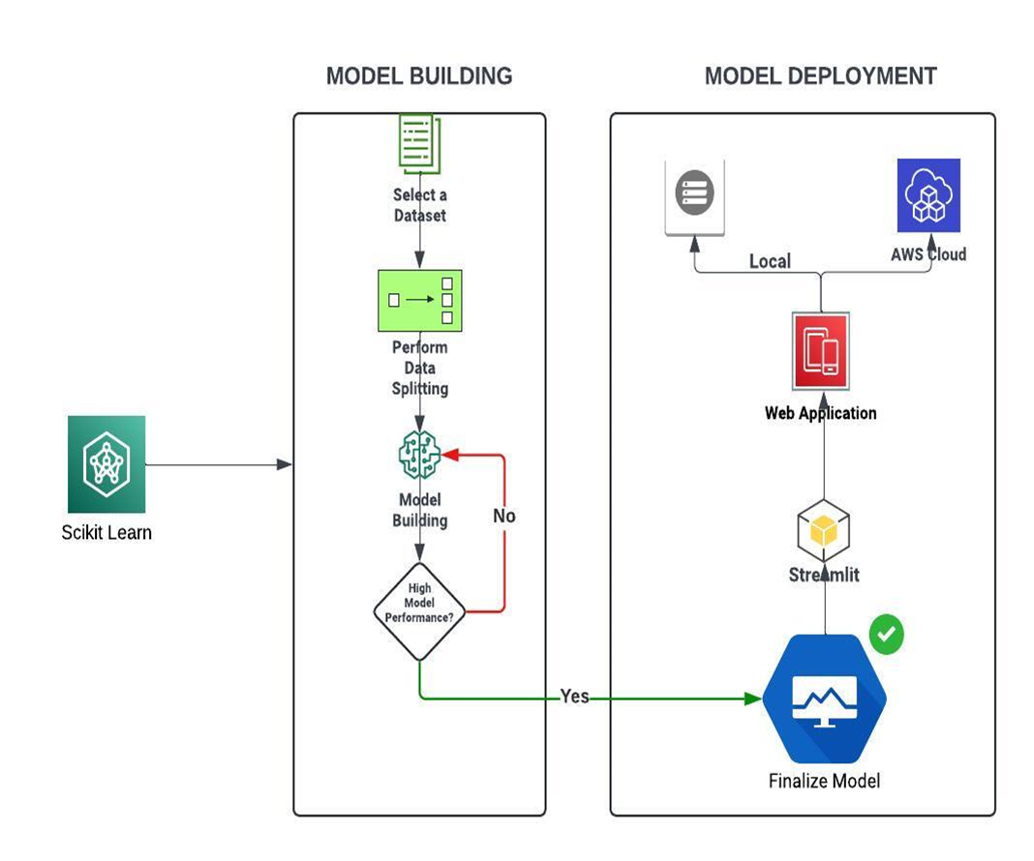
System design

Slide 7

technology
StandardScaler was implemented to scale the numerical variables.
OneHotEncoder, OrdinalEncoder were implemented to create dummy variables for categorical variables.
Hyperparameter tuning was also successfully implemented.
Successfully deployed the Interface to the Streamlit Cloud using Streamlit application in Python.
To obtain better performance various Machine Learning algorithms were implemented.
Finalized Random Forest Model with 500 decision tree estimators, as it gave the highest accuracy of 90%

Slide 8
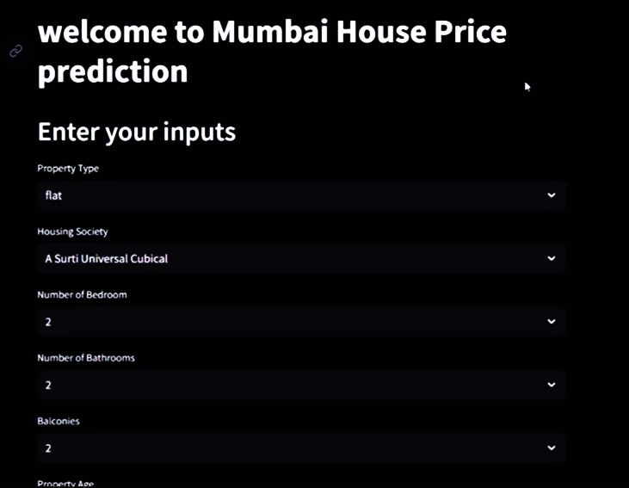
technology

Slide 9

demo

Slide 10
Future work
We can incorporate advanced techniques, such as deep learning and natural language processing, to capture subjective factors and sentiment analysis from property descriptions and reviews.
We can enhance the user interface with interactive visualizations, personalized recommendations, and market trends analysis to offer users a more immersive and informative experience.

Slide 11
THANK YOU

